Slide 1
Hospice of St. Francis, Inc.
Strategic Marketing Services
March 2014
About Brandt Ronat + Co.

Slide 2
ABOUT BRANDT RONAT + CO.
23 Years in Brevard
Located in Merritt Island
Experienced staff
Wide variety of ‘in-house’ services
Non-profit work
Process driven
Collaborative
Strategically creative
Solid references
Media buying and negotiation
Health & Wellness

Slide 3
Hospice of St. Francis, Inc.
Strategic Marketing Services
March 2014
Process

Slide 4
Marketing Approach and Philosophy (Process)
brandt ronat + company uses an evidence-based approach to creative development. We call this Analytical Creative.

Slide 5
Marketing Approach and Philosophy (Process)

Slide 6
Hospice of St. Francis, Inc.
Strategic Marketing Services
March 2014
Sample Work

Slide 9
Notes:
Brandt Ronat’s recommendation for positioning Palm Bay’s economic development outreach is in one part centered around the simplicity of the phrase itself and its effectively unassuming opening and surprisingly powerful stance, when seen in context of its many, many positive, related implications.
The idea of being ‘down to earth’ has edges.
It is not expected.
It is not something every City can say or then also load with actual relevant business or economic development value.
It is a way to identify the essential (and hidden, not instantly seen, vast and secret) economic opportunity within Palm Bay.
‘Down to earth’ is also a way to honor the residents and support the incredible natural assets of Palm Bay.
It allows us to secondarily and effectively focus on all of the wonderful assets its land and people offer. While the clear opportunity for growth is the vast available, affordable land and lease offers, the City of Palm Bay has other assets that provide for a winning combination.
It is crucial to note the underpinnings in the phrase: and explore its other stunning resonating implications.
From this we can provide a full portrait of a geographically and recreationally rich area, unsurpassed beauty and a lifestyle in Florida that is enviable.
The creative concept of being ‘down to earth’ literally establishes Palm Bay as a welcoming place of opportunity with a strong identity and solving nature.
It implicates a willingness by the City and its people to create options to make innovative development come true, find ways to consider a good idea, make doors open, support the processes, such as ways to accelerate permitting or other steps to get a business up and running and earning.
The traditional use of the phrase down to earth is a phrase attributed to ‘people’ which we think is an important point—that this profiles the people of the City of Palm Bay as accessible, direct, friendly, have conversations, meet you on level ground and look you in the eye, and are open to you and your ideas, your heritage, your business premise, your needs and your family of employees.

Slide 10
ENVIRONMENT
Notes:
CLUES: Palm Bay represents Openness:
1. Open and available richness and sheer amount of land 2. Innovative leaders Open to working a solution (grounded, down to earth people, not afraid to get their hands in and help solve) 3. Open-ended opportunity in an area that is EMERGING. With people that are open.

Slide 11
ECONOMICS
Notes:
CLUES: Palm Bay represents Openness:
1. Open and available richness and sheer amount of land 2. Innovative leaders Open to working a solution (grounded, down to earth people, not afraid to get their hands in and help solve) 3. Open-ended opportunity in an area that is EMERGING. With people that are open.

Slide 12
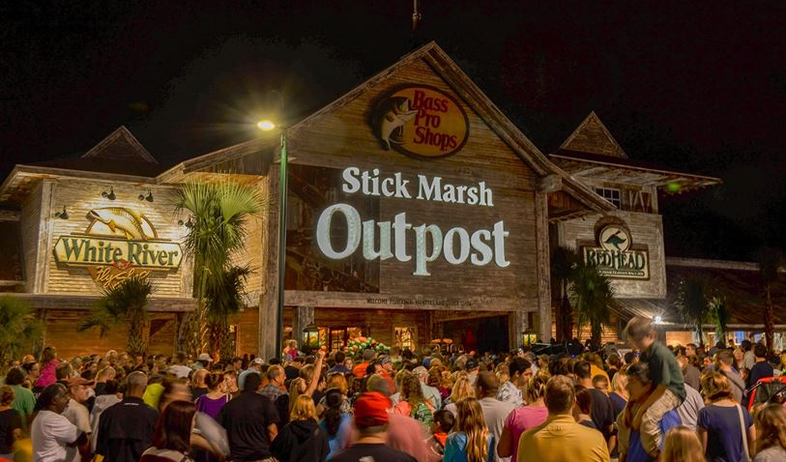
EMERGING
Notes:
CLUES: Palm Bay represents Openness:
1. Open and available richness and sheer amount of land 2. Innovative leaders Open to working a solution (grounded, down to earth people, not afraid to get their hands in and help solve) 3. Open-ended opportunity in an area that is EMERGING. With people that are open.

Slide 13
Notes:
Brandt Ronat’s recommendation for positioning Palm Bay’s economic development outreach is in one part centered around the simplicity of the phrase itself and its effectively unassuming opening and surprisingly powerful stance, when seen in context of its many, many positive, related implications.
The idea of being ‘down to earth’ has edges.
It is not expected.
It is not something every City can say or then also load with actual relevant business or economic development value.
It is a way to identify the essential (and hidden, not instantly seen, vast and secret) economic opportunity within Palm Bay.
‘Down to earth’ is also a way to honor the residents and support the incredible natural assets of Palm Bay.
It allows us to secondarily and effectively focus on all of the wonderful assets its land and people offer. While the clear opportunity for growth is the vast available, affordable land and lease offers, the City of Palm Bay has other assets that provide for a winning combination.
It is crucial to note the underpinnings in the phrase: and explore its other stunning resonating implications.
From this we can provide a full portrait of a geographically and recreationally rich area, unsurpassed beauty and a lifestyle in Florida that is enviable.
The creative concept of being ‘down to earth’ literally establishes Palm Bay as a welcoming place of opportunity with a strong identity and solving nature.
It implicates a willingness by the City and its people to create options to make innovative development come true, find ways to consider a good idea, make doors open, support the processes, such as ways to accelerate permitting or other steps to get a business up and running and earning.
The traditional use of the phrase down to earth is a phrase attributed to ‘people’ which we think is an important point—that this profiles the people of the City of Palm Bay as accessible, direct, friendly, have conversations, meet you on level ground and look you in the eye, and are open to you and your ideas, your heritage, your business premise, your needs and your family of employees.

Slide 14
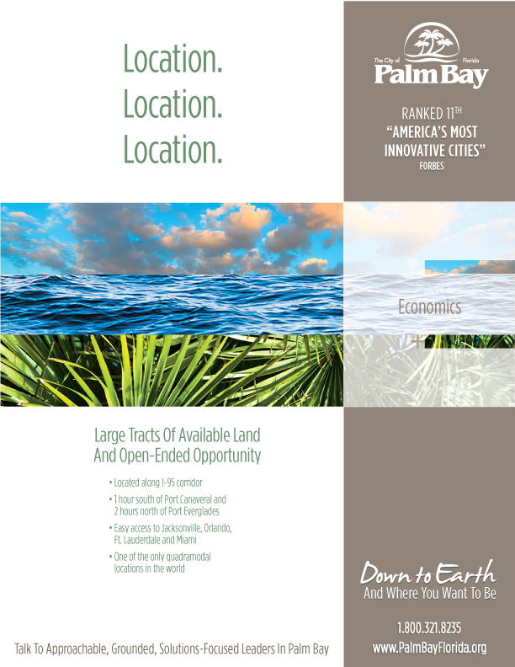
Notes:
Brandt Ronat’s recommendation for positioning Palm Bay’s economic development outreach is in one part centered around the simplicity of the phrase itself and its effectively unassuming opening and surprisingly powerful stance, when seen in context of its many, many positive, related implications.
The idea of being ‘down to earth’ has edges.
It is not expected.
It is not something every City can say or then also load with actual relevant business or economic development value.
It is a way to identify the essential (and hidden, not instantly seen, vast and secret) economic opportunity within Palm Bay.
‘Down to earth’ is also a way to honor the residents and support the incredible natural assets of Palm Bay.
It allows us to secondarily and effectively focus on all of the wonderful assets its land and people offer. While the clear opportunity for growth is the vast available, affordable land and lease offers, the City of Palm Bay has other assets that provide for a winning combination.
It is crucial to note the underpinnings in the phrase: and explore its other stunning resonating implications.
From this we can provide a full portrait of a geographically and recreationally rich area, unsurpassed beauty and a lifestyle in Florida that is enviable.
The creative concept of being ‘down to earth’ literally establishes Palm Bay as a welcoming place of opportunity with a strong identity and solving nature.
It implicates a willingness by the City and its people to create options to make innovative development come true, find ways to consider a good idea, make doors open, support the processes, such as ways to accelerate permitting or other steps to get a business up and running and earning.
The traditional use of the phrase down to earth is a phrase attributed to ‘people’ which we think is an important point—that this profiles the people of the City of Palm Bay as accessible, direct, friendly, have conversations, meet you on level ground and look you in the eye, and are open to you and your ideas, your heritage, your business premise, your needs and your family of employees.

Slide 15
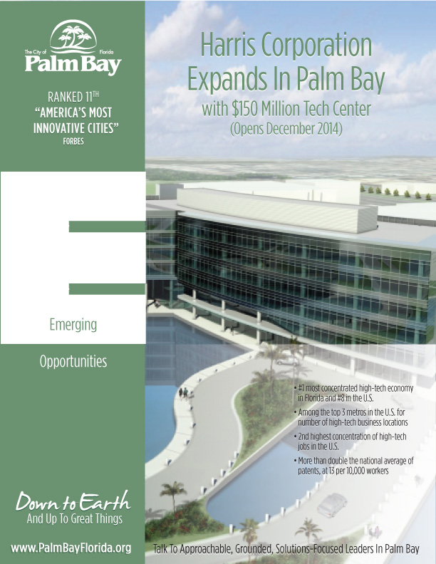
Notes:
Brandt Ronat’s recommendation for positioning Palm Bay’s economic development outreach is in one part centered around the simplicity of the phrase itself and its effectively unassuming opening and surprisingly powerful stance, when seen in context of its many, many positive, related implications.
The idea of being ‘down to earth’ has edges.
It is not expected.
It is not something every City can say or then also load with actual relevant business or economic development value.
It is a way to identify the essential (and hidden, not instantly seen, vast and secret) economic opportunity within Palm Bay.
‘Down to earth’ is also a way to honor the residents and support the incredible natural assets of Palm Bay.
It allows us to secondarily and effectively focus on all of the wonderful assets its land and people offer. While the clear opportunity for growth is the vast available, affordable land and lease offers, the City of Palm Bay has other assets that provide for a winning combination.
It is crucial to note the underpinnings in the phrase: and explore its other stunning resonating implications.
From this we can provide a full portrait of a geographically and recreationally rich area, unsurpassed beauty and a lifestyle in Florida that is enviable.
The creative concept of being ‘down to earth’ literally establishes Palm Bay as a welcoming place of opportunity with a strong identity and solving nature.
It implicates a willingness by the City and its people to create options to make innovative development come true, find ways to consider a good idea, make doors open, support the processes, such as ways to accelerate permitting or other steps to get a business up and running and earning.
The traditional use of the phrase down to earth is a phrase attributed to ‘people’ which we think is an important point—that this profiles the people of the City of Palm Bay as accessible, direct, friendly, have conversations, meet you on level ground and look you in the eye, and are open to you and your ideas, your heritage, your business premise, your needs and your family of employees.

Slide 16
Notes:
Brandt Ronat’s recommendation for positioning Palm Bay’s economic development outreach is in one part centered around the simplicity of the phrase itself and its effectively unassuming opening and surprisingly powerful stance, when seen in context of its many, many positive, related implications.
The idea of being ‘down to earth’ has edges.
It is not expected.
It is not something every City can say or then also load with actual relevant business or economic development value.
It is a way to identify the essential (and hidden, not instantly seen, vast and secret) economic opportunity within Palm Bay.
‘Down to earth’ is also a way to honor the residents and support the incredible natural assets of Palm Bay.
It allows us to secondarily and effectively focus on all of the wonderful assets its land and people offer. While the clear opportunity for growth is the vast available, affordable land and lease offers, the City of Palm Bay has other assets that provide for a winning combination.
It is crucial to note the underpinnings in the phrase: and explore its other stunning resonating implications.
From this we can provide a full portrait of a geographically and recreationally rich area, unsurpassed beauty and a lifestyle in Florida that is enviable.
The creative concept of being ‘down to earth’ literally establishes Palm Bay as a welcoming place of opportunity with a strong identity and solving nature.
It implicates a willingness by the City and its people to create options to make innovative development come true, find ways to consider a good idea, make doors open, support the processes, such as ways to accelerate permitting or other steps to get a business up and running and earning.
The traditional use of the phrase down to earth is a phrase attributed to ‘people’ which we think is an important point—that this profiles the people of the City of Palm Bay as accessible, direct, friendly, have conversations, meet you on level ground and look you in the eye, and are open to you and your ideas, your heritage, your business premise, your needs and your family of employees.

Slide 17
Notes:
Brandt Ronat’s recommendation for positioning Palm Bay’s economic development outreach is in one part centered around the simplicity of the phrase itself and its effectively unassuming opening and surprisingly powerful stance, when seen in context of its many, many positive, related implications.
The idea of being ‘down to earth’ has edges.
It is not expected.
It is not something every City can say or then also load with actual relevant business or economic development value.
It is a way to identify the essential (and hidden, not instantly seen, vast and secret) economic opportunity within Palm Bay.
‘Down to earth’ is also a way to honor the residents and support the incredible natural assets of Palm Bay.
It allows us to secondarily and effectively focus on all of the wonderful assets its land and people offer. While the clear opportunity for growth is the vast available, affordable land and lease offers, the City of Palm Bay has other assets that provide for a winning combination.
It is crucial to note the underpinnings in the phrase: and explore its other stunning resonating implications.
From this we can provide a full portrait of a geographically and recreationally rich area, unsurpassed beauty and a lifestyle in Florida that is enviable.
The creative concept of being ‘down to earth’ literally establishes Palm Bay as a welcoming place of opportunity with a strong identity and solving nature.
It implicates a willingness by the City and its people to create options to make innovative development come true, find ways to consider a good idea, make doors open, support the processes, such as ways to accelerate permitting or other steps to get a business up and running and earning.
The traditional use of the phrase down to earth is a phrase attributed to ‘people’ which we think is an important point—that this profiles the people of the City of Palm Bay as accessible, direct, friendly, have conversations, meet you on level ground and look you in the eye, and are open to you and your ideas, your heritage, your business premise, your needs and your family of employees.

Slide 18
Notes:
Brandt Ronat’s recommendation for positioning Palm Bay’s economic development outreach is in one part centered around the simplicity of the phrase itself and its effectively unassuming opening and surprisingly powerful stance, when seen in context of its many, many positive, related implications.
The idea of being ‘down to earth’ has edges.
It is not expected.
It is not something every City can say or then also load with actual relevant business or economic development value.
It is a way to identify the essential (and hidden, not instantly seen, vast and secret) economic opportunity within Palm Bay.
‘Down to earth’ is also a way to honor the residents and support the incredible natural assets of Palm Bay.
It allows us to secondarily and effectively focus on all of the wonderful assets its land and people offer. While the clear opportunity for growth is the vast available, affordable land and lease offers, the City of Palm Bay has other assets that provide for a winning combination.
It is crucial to note the underpinnings in the phrase: and explore its other stunning resonating implications.
From this we can provide a full portrait of a geographically and recreationally rich area, unsurpassed beauty and a lifestyle in Florida that is enviable.
The creative concept of being ‘down to earth’ literally establishes Palm Bay as a welcoming place of opportunity with a strong identity and solving nature.
It implicates a willingness by the City and its people to create options to make innovative development come true, find ways to consider a good idea, make doors open, support the processes, such as ways to accelerate permitting or other steps to get a business up and running and earning.
The traditional use of the phrase down to earth is a phrase attributed to ‘people’ which we think is an important point—that this profiles the people of the City of Palm Bay as accessible, direct, friendly, have conversations, meet you on level ground and look you in the eye, and are open to you and your ideas, your heritage, your business premise, your needs and your family of employees.

Slide 19
Notes:
Brandt Ronat’s recommendation for positioning Palm Bay’s economic development outreach is in one part centered around the simplicity of the phrase itself and its effectively unassuming opening and surprisingly powerful stance, when seen in context of its many, many positive, related implications.
The idea of being ‘down to earth’ has edges.
It is not expected.
It is not something every City can say or then also load with actual relevant business or economic development value.
It is a way to identify the essential (and hidden, not instantly seen, vast and secret) economic opportunity within Palm Bay.
‘Down to earth’ is also a way to honor the residents and support the incredible natural assets of Palm Bay.
It allows us to secondarily and effectively focus on all of the wonderful assets its land and people offer. While the clear opportunity for growth is the vast available, affordable land and lease offers, the City of Palm Bay has other assets that provide for a winning combination.
It is crucial to note the underpinnings in the phrase: and explore its other stunning resonating implications.
From this we can provide a full portrait of a geographically and recreationally rich area, unsurpassed beauty and a lifestyle in Florida that is enviable.
The creative concept of being ‘down to earth’ literally establishes Palm Bay as a welcoming place of opportunity with a strong identity and solving nature.
It implicates a willingness by the City and its people to create options to make innovative development come true, find ways to consider a good idea, make doors open, support the processes, such as ways to accelerate permitting or other steps to get a business up and running and earning.
The traditional use of the phrase down to earth is a phrase attributed to ‘people’ which we think is an important point—that this profiles the people of the City of Palm Bay as accessible, direct, friendly, have conversations, meet you on level ground and look you in the eye, and are open to you and your ideas, your heritage, your business premise, your needs and your family of employees.

Slide 20
Notes:
Brandt Ronat’s recommendation for positioning Palm Bay’s economic development outreach is in one part centered around the simplicity of the phrase itself and its effectively unassuming opening and surprisingly powerful stance, when seen in context of its many, many positive, related implications.
The idea of being ‘down to earth’ has edges.
It is not expected.
It is not something every City can say or then also load with actual relevant business or economic development value.
It is a way to identify the essential (and hidden, not instantly seen, vast and secret) economic opportunity within Palm Bay.
‘Down to earth’ is also a way to honor the residents and support the incredible natural assets of Palm Bay.
It allows us to secondarily and effectively focus on all of the wonderful assets its land and people offer. While the clear opportunity for growth is the vast available, affordable land and lease offers, the City of Palm Bay has other assets that provide for a winning combination.
It is crucial to note the underpinnings in the phrase: and explore its other stunning resonating implications.
From this we can provide a full portrait of a geographically and recreationally rich area, unsurpassed beauty and a lifestyle in Florida that is enviable.
The creative concept of being ‘down to earth’ literally establishes Palm Bay as a welcoming place of opportunity with a strong identity and solving nature.
It implicates a willingness by the City and its people to create options to make innovative development come true, find ways to consider a good idea, make doors open, support the processes, such as ways to accelerate permitting or other steps to get a business up and running and earning.
The traditional use of the phrase down to earth is a phrase attributed to ‘people’ which we think is an important point—that this profiles the people of the City of Palm Bay as accessible, direct, friendly, have conversations, meet you on level ground and look you in the eye, and are open to you and your ideas, your heritage, your business premise, your needs and your family of employees.

Slide 21
Notes:
Brandt Ronat’s recommendation for positioning Palm Bay’s economic development outreach is in one part centered around the simplicity of the phrase itself and its effectively unassuming opening and surprisingly powerful stance, when seen in context of its many, many positive, related implications.
The idea of being ‘down to earth’ has edges.
It is not expected.
It is not something every City can say or then also load with actual relevant business or economic development value.
It is a way to identify the essential (and hidden, not instantly seen, vast and secret) economic opportunity within Palm Bay.
‘Down to earth’ is also a way to honor the residents and support the incredible natural assets of Palm Bay.
It allows us to secondarily and effectively focus on all of the wonderful assets its land and people offer. While the clear opportunity for growth is the vast available, affordable land and lease offers, the City of Palm Bay has other assets that provide for a winning combination.
It is crucial to note the underpinnings in the phrase: and explore its other stunning resonating implications.
From this we can provide a full portrait of a geographically and recreationally rich area, unsurpassed beauty and a lifestyle in Florida that is enviable.
The creative concept of being ‘down to earth’ literally establishes Palm Bay as a welcoming place of opportunity with a strong identity and solving nature.
It implicates a willingness by the City and its people to create options to make innovative development come true, find ways to consider a good idea, make doors open, support the processes, such as ways to accelerate permitting or other steps to get a business up and running and earning.
The traditional use of the phrase down to earth is a phrase attributed to ‘people’ which we think is an important point—that this profiles the people of the City of Palm Bay as accessible, direct, friendly, have conversations, meet you on level ground and look you in the eye, and are open to you and your ideas, your heritage, your business premise, your needs and your family of employees.

Slide 22
Notes:
Brandt Ronat’s recommendation for positioning Palm Bay’s economic development outreach is in one part centered around the simplicity of the phrase itself and its effectively unassuming opening and surprisingly powerful stance, when seen in context of its many, many positive, related implications.
The idea of being ‘down to earth’ has edges.
It is not expected.
It is not something every City can say or then also load with actual relevant business or economic development value.
It is a way to identify the essential (and hidden, not instantly seen, vast and secret) economic opportunity within Palm Bay.
‘Down to earth’ is also a way to honor the residents and support the incredible natural assets of Palm Bay.
It allows us to secondarily and effectively focus on all of the wonderful assets its land and people offer. While the clear opportunity for growth is the vast available, affordable land and lease offers, the City of Palm Bay has other assets that provide for a winning combination.
It is crucial to note the underpinnings in the phrase: and explore its other stunning resonating implications.
From this we can provide a full portrait of a geographically and recreationally rich area, unsurpassed beauty and a lifestyle in Florida that is enviable.
The creative concept of being ‘down to earth’ literally establishes Palm Bay as a welcoming place of opportunity with a strong identity and solving nature.
It implicates a willingness by the City and its people to create options to make innovative development come true, find ways to consider a good idea, make doors open, support the processes, such as ways to accelerate permitting or other steps to get a business up and running and earning.
The traditional use of the phrase down to earth is a phrase attributed to ‘people’ which we think is an important point—that this profiles the people of the City of Palm Bay as accessible, direct, friendly, have conversations, meet you on level ground and look you in the eye, and are open to you and your ideas, your heritage, your business premise, your needs and your family of employees.

Slide 23
Notes:
Brandt Ronat’s recommendation for positioning Palm Bay’s economic development outreach is in one part centered around the simplicity of the phrase itself and its effectively unassuming opening and surprisingly powerful stance, when seen in context of its many, many positive, related implications.
The idea of being ‘down to earth’ has edges.
It is not expected.
It is not something every City can say or then also load with actual relevant business or economic development value.
It is a way to identify the essential (and hidden, not instantly seen, vast and secret) economic opportunity within Palm Bay.
‘Down to earth’ is also a way to honor the residents and support the incredible natural assets of Palm Bay.
It allows us to secondarily and effectively focus on all of the wonderful assets its land and people offer. While the clear opportunity for growth is the vast available, affordable land and lease offers, the City of Palm Bay has other assets that provide for a winning combination.
It is crucial to note the underpinnings in the phrase: and explore its other stunning resonating implications.
From this we can provide a full portrait of a geographically and recreationally rich area, unsurpassed beauty and a lifestyle in Florida that is enviable.
The creative concept of being ‘down to earth’ literally establishes Palm Bay as a welcoming place of opportunity with a strong identity and solving nature.
It implicates a willingness by the City and its people to create options to make innovative development come true, find ways to consider a good idea, make doors open, support the processes, such as ways to accelerate permitting or other steps to get a business up and running and earning.
The traditional use of the phrase down to earth is a phrase attributed to ‘people’ which we think is an important point—that this profiles the people of the City of Palm Bay as accessible, direct, friendly, have conversations, meet you on level ground and look you in the eye, and are open to you and your ideas, your heritage, your business premise, your needs and your family of employees.

Slide 24
Notes:
Brandt Ronat’s recommendation for positioning Palm Bay’s economic development outreach is in one part centered around the simplicity of the phrase itself and its effectively unassuming opening and surprisingly powerful stance, when seen in context of its many, many positive, related implications.
The idea of being ‘down to earth’ has edges.
It is not expected.
It is not something every City can say or then also load with actual relevant business or economic development value.
It is a way to identify the essential (and hidden, not instantly seen, vast and secret) economic opportunity within Palm Bay.
‘Down to earth’ is also a way to honor the residents and support the incredible natural assets of Palm Bay.
It allows us to secondarily and effectively focus on all of the wonderful assets its land and people offer. While the clear opportunity for growth is the vast available, affordable land and lease offers, the City of Palm Bay has other assets that provide for a winning combination.
It is crucial to note the underpinnings in the phrase: and explore its other stunning resonating implications.
From this we can provide a full portrait of a geographically and recreationally rich area, unsurpassed beauty and a lifestyle in Florida that is enviable.
The creative concept of being ‘down to earth’ literally establishes Palm Bay as a welcoming place of opportunity with a strong identity and solving nature.
It implicates a willingness by the City and its people to create options to make innovative development come true, find ways to consider a good idea, make doors open, support the processes, such as ways to accelerate permitting or other steps to get a business up and running and earning.
The traditional use of the phrase down to earth is a phrase attributed to ‘people’ which we think is an important point—that this profiles the people of the City of Palm Bay as accessible, direct, friendly, have conversations, meet you on level ground and look you in the eye, and are open to you and your ideas, your heritage, your business premise, your needs and your family of employees.

Slide 25
Notes:
Brandt Ronat’s recommendation for positioning Palm Bay’s economic development outreach is in one part centered around the simplicity of the phrase itself and its effectively unassuming opening and surprisingly powerful stance, when seen in context of its many, many positive, related implications.
The idea of being ‘down to earth’ has edges.
It is not expected.
It is not something every City can say or then also load with actual relevant business or economic development value.
It is a way to identify the essential (and hidden, not instantly seen, vast and secret) economic opportunity within Palm Bay.
‘Down to earth’ is also a way to honor the residents and support the incredible natural assets of Palm Bay.
It allows us to secondarily and effectively focus on all of the wonderful assets its land and people offer. While the clear opportunity for growth is the vast available, affordable land and lease offers, the City of Palm Bay has other assets that provide for a winning combination.
It is crucial to note the underpinnings in the phrase: and explore its other stunning resonating implications.
From this we can provide a full portrait of a geographically and recreationally rich area, unsurpassed beauty and a lifestyle in Florida that is enviable.
The creative concept of being ‘down to earth’ literally establishes Palm Bay as a welcoming place of opportunity with a strong identity and solving nature.
It implicates a willingness by the City and its people to create options to make innovative development come true, find ways to consider a good idea, make doors open, support the processes, such as ways to accelerate permitting or other steps to get a business up and running and earning.
The traditional use of the phrase down to earth is a phrase attributed to ‘people’ which we think is an important point—that this profiles the people of the City of Palm Bay as accessible, direct, friendly, have conversations, meet you on level ground and look you in the eye, and are open to you and your ideas, your heritage, your business premise, your needs and your family of employees.

Slide 26
Name. Brand. Positioning. Community Benefit Organization.
LEAD BREVARD

Slide 27
Campaign Concept and Design. Development
RIVER PRESERVE

Slide 28
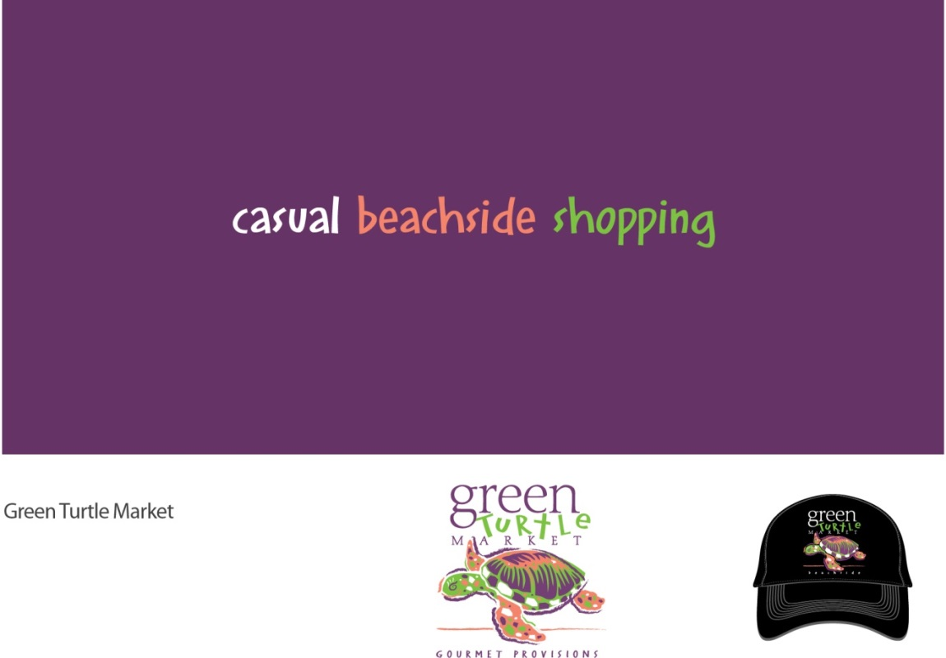
Brand. Campaign. Startup. Illustration.
GREEN TURTLE

Slide 29
Brand. Campaign. Media Planning. Digital. Redevelopment.
ART & ALGORITHMS

Slide 30
Brand. Campaign. Media. Development.
SUMMER LAKES - VIERA

Slide 31
Campaign. Facility Launch. Health & Wellness.
HEALTH FIRST HEART CENTER

Slide 32
Brand. 500 Year Old Hospital. Campaign. Positioning. Health & Wellness. Spanish.
HOSPITAL DE LA CONCEPCION – PUERTO RICO

Slide 33
Brand. Campaign. Development. Golf.
WYNDHAM AT DURAN / DURAN GOLF - VIERA

Slide 34
Brand. Startup. Entrepreneurship. University Cooperative.
MEGAWATT VENTURES

Slide 35
Naming. Brand. Positioning. Community Benefit Organization.
AGING MATTERS IN BREVARD

Slide 36
Brand. Campaign. Media. Startup. Health & Wellness.
ESSENTIALS SPA

Slide 37
Name. Positioning. Media. Campaign. State of Wyoming Partnership.
OUR FAMILIES OUR FUTURE

Slide 38
Brand. Campaign. Media. Digital.
BREVARD WILDLIFE CORRIDOR EXPEDITION

Slide 39
Hospice of St. Francis, Inc.
Strategic Marketing Services
March 2014
Timing

Slide 40
TIMING
60-90 Days to completion of Phase I.
90 Days to completion of Phase II. Defined as the add-on marketing applications needed to support campaign
Phase III. Implementation (On-going) Review; Refine; Assess

Slide 41
Hospice of St. Francis, Inc.
Strategic Marketing Services
March 2014
Goals

Slide 42
GOALS
Create recognition of Name and Brand (logo, colors, etc.) throughout Brevard County.
Educate consumers (target audiences) on what services HOSF provides; when to ask for those services; how to ask (to physicians, facility managers, etc.); and that hospice is a choice and you can choose Hospice of St. Francis over other hospices.

Slide 43
GOALS
Develop specific marketing strategies for individual referral sources---Physician, Nursing Facility managers, Assisted Living Facility operators, middle age females, etc.—to make HOSF the preferred hospice provider. Focus on why HOSF should be your preferred provider.
Promote Care Center as part of the “HOSF” package of services

Slide 44
GOALS
Evaluate and recommend use of Social Media to promote hospice services
Touch people in more than just an informational way; get to their emotions
Define how to objectively measure success in each of the six preceding goals

Slide 45
Hospice of St. Francis, Inc.
Strategic Marketing Services
March 2014
Budget

Slide 46
BUDGET
Phase I. $13,000. (50% billed to initiate)
Includes in kind credit of $2,000.
Phase II. To Be Estimated to Support Custom Plan

