Slide 1
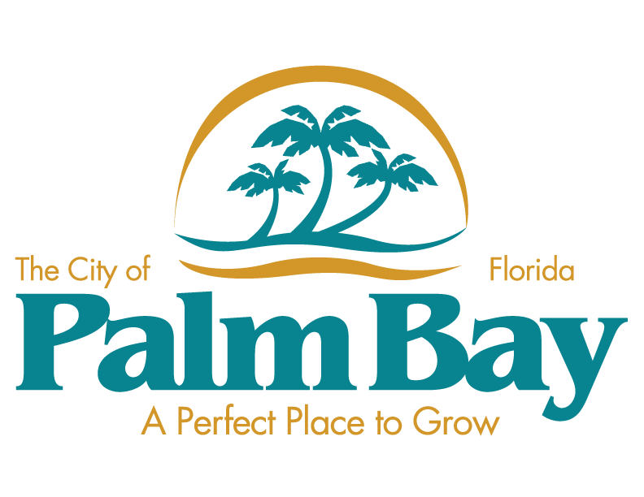
FORWARD
After the Focus Groups
WHAT’S NEXT
Mindspot Research

Slide 2
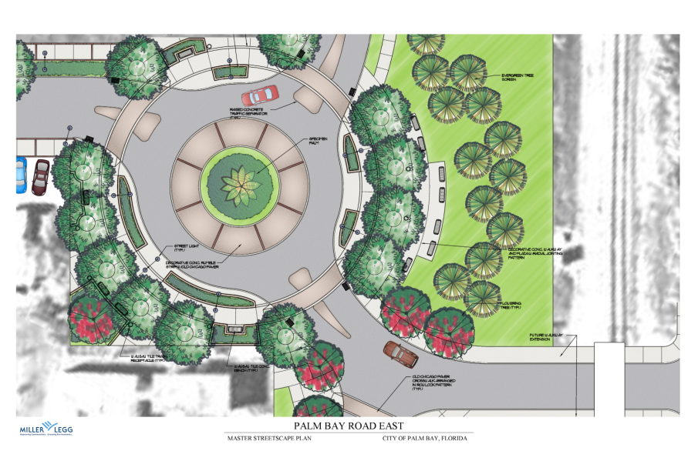
STRATEGIC PLATFORM
For Communications
Opportunities

Slide 3
KEY CHALLENGE
KEY: Create a strong economic development focus that supports the true attributes of the City of Palm Bay and resonates with business (existing, expanding or inquiring), the residents and visitors.
Minspot Rsearch
Notes:
This whole thing is about messages, communications...cohesive voice, bigger more powerful voice, understanding and engagement.

Slide 4
Breaking non-productive patterns
Breaking the pattern of old tape recordings, old messages: Messages only really change when you replace them with better messages.
Improved conversations lead to:
Engagement
Linkages
Realistic possibilities, actions
Mindspot Research

Slide 5
STRATEGIC PLATFORM 1
1. Current feedback from community leaders and stakeholders suggests that past negative perceptions about the area still have traction with the need for a cohesive position and direction to support the City in its economic development efforts.
Mindspot Research

Slide 6
STRATEGIC PLATFORM 2
2. Palm Bay is looking for an economic development outreach focus with emphasis on recruitment and retention of business and industry that is based on realistic opportunities for an achievable future.
Mindspot Research

Slide 7
STRATEGIC PLATFORM 3
3. Palm Bay is not looking for a quick fix but rather a great future for its citizens, focusing on incremental wins within a long-term positioning grounded by strategic endeavors, and understood by its citizens and others who can support or influence success.
Mindspot Research

Slide 8
INSIGHT validated
Stakeholder research says:
the economic development advantage the City of Palm Bay has is the availability, abundance and relative affordability of the land.
Mindspot Research
Notes:
ACTION: Strategically, we want to expand on the idea of the rare abundance as a foundation, promoting the land asset and showing stewardship for the future. That carries with it certain messages, intentions and responsibilities, but also all of the excitement and implications that platform evokes.

Slide 9
CRITICAL INSIGHT
HEART: Palm Bay is the largest city in Brevard County and 2th largest city in Central Florida, while only being 30% built-out, which offers high potential for growth, innovation and opportunities for businesses, both domestic and international.
Mindspot Research

Slide 10
LEVERAGE IS THE ISSUE
RELEVANT: Leaders know their land and central proximity within the state are economic assets; but the idea of how to position and leverage that in a strategy has not yet been solved.
Notes:
This whole thing is about messages, communications...cohesive voice, bigger more powerful voice, understanding and engagement.

Slide 11
LEVERAGE IS THE ISSUE
ALSO RELEVANT: The city has a small town flavor, cultural diversity and a down-to-earth hard working mentality.
Notes:
This whole thing is about messages, communications...cohesive voice, bigger more powerful voice, understanding and engagement.

Slide 12
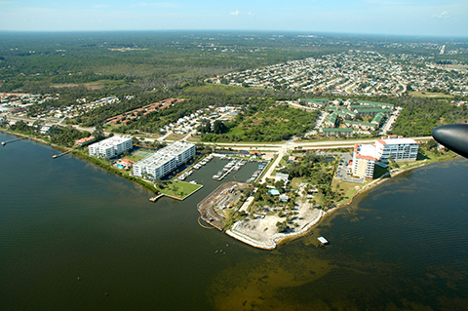
messages
Focus Cluster #1:
Open Available Land, Great Value
Climate, Geography, Unique Options
Affordable to innovate, areas where open land allows option to invest in infrastructure, new industry or very big dreams
Mindspot Research
Notes:
Open Land and Open Opportunity — Wide open spaces, a priceless asset in terms of future growth, tracks of virtually any size, in an area where sustainability of the land is possible
without extreme measures to reverse existing activities, where mega enterprises and other infrastructure-rich investments and innovations can be feasibly considered.
This is a powerful positioning statement and one most communities cannot make.

Slide 13
messages
Focus Cluster #2:
Environment
Extreme beauty, climate, year-round
Outdoor living, recreational abundance and variety
Healthy active lives
Works for Families, Employers
Mindspot Research

Slide 14
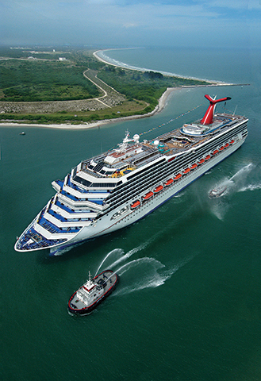
messages
Focus Cluster #3:
Proximity
Location and access, geography
Growth, ports, airports
Supply chain logic, shipping
Growth of trade
Quadramodal transportation
Mindspot Research
Notes:
The Power of Proximity —Location and Access, between Miami, Orlando and Jacksonville, and beyond allows for shipping logistics and supply chain advantages, coupled with our economically expanding Ports, to north and south, and the global message of Quadra-modal Transportation, which exists few places in the world. Location, location, location.

Slide 15
messages
Focus Cluster #4:
Cultural Diversity
Invites certain kinds of businesses
Makes transfer from another culture or country easier
Helps grow smart global citizens
Textures the offerings, textures the fun
Mindspot Research
Notes:
Cultural Diversity. Positioning Palm Bay as part of the Global Community, with Openness to Ideas, an Opportunity to Belong, a Respect for Differences and Traditions -- where our youth can actually prepare for a world of opportunities, be able to thrive in a diverse world, become good and savvy citizens of the globe, in a safe place to grow. Offering global perspectives and support for business.

Slide 16
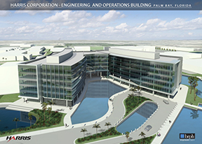
messages
Focuses #5-10:
Juggernauts
Technology giants
Recreation and Tourism giants
Trade giants, Cruise & Cargo growth
Brazilian presence, fit, momentum
Cultural Tourism catalyst potential
Mindspot Research

Slide 17
messages
Focus #11:
Sustainable Innovation
Green technologies growth
Ripe for big ideas and innovative companies, new industries
Land options, capital investment is in infrastructure vs. the land
Mindspot Research

Slide 18
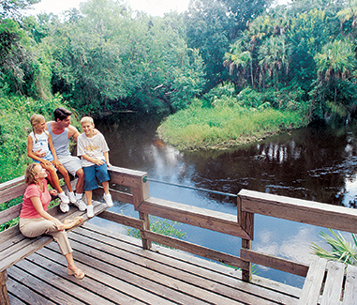
messages
Focus #12:
Character, Open, Grounded
Solving, diverse, welcoming
Education, talent & tech rich
Family & citizen focused, with parks, adventures, healthy living
Mindspot Research
Notes:
Openness — This secondary theme naturally recurs. Palm Bay represents openness in many ways: open spaces, land; open to unique or innovative land-use solutions; the incredible open spaces outdoors; population diversity; openly family oriented, with family-centric values; grounded; efforts to create a safe and open city; a global outlook; welcoming; open-ended opportunity. Emerging, not concluding.

Slide 19
FOCUSES TO SUPPORT STRATEGY
Outdoor Recreation & the promise of a Quality, Healthy Lifestyle – The Triple Threat.
1. Quality of Life for Business Owners and their Employees, easier to get them to transfer here, get rooted here. Advantage Palm Bay.
Mindspot Research

Slide 20
FOCUSES TO SUPPORT STRATEGY
Outdoor Recreation & the promise of a Quality, Healthy Lifestyle – The Triple Threat.
2. Growing Tourism--Abundant Natural Assets and the Opportunity to Enhance and Attract Visitors (and their new dollars) by growing the recreation opportunity, utilizing the land.
Mindspot Research

Slide 21
FOCUSES TO SUPPORT STRATEGY
Outdoor Recreation & the promise of a Quality, Healthy Lifestyle – The Triple Threat.
3. Enriched Environment for Generational Connectivity and Prosperity–attracts generations of families, generational businesses, returning youth filling talent pipelines, generational success.
Mindspot Research
Notes:
That is very grounding. Generational connectivity, citizen satisfaction, generationally powerful stories, long term voice. And health

Slide 22
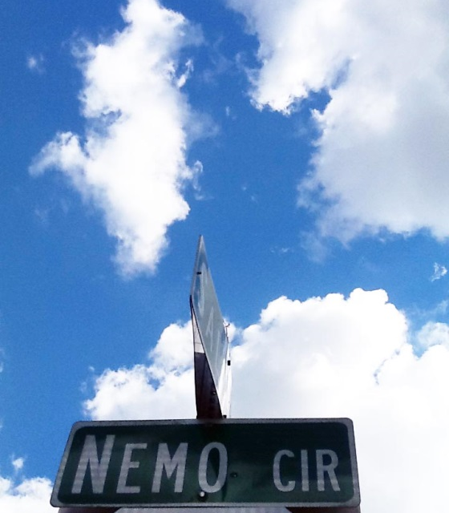
POSITIVE
Signs
Opportunities & Actions

Slide 23
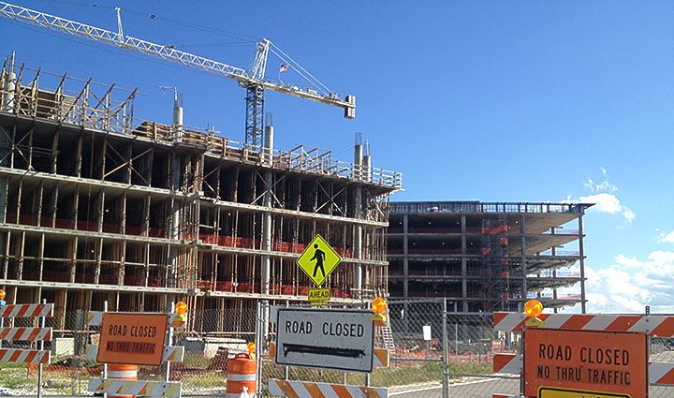
Signs of vitality

Slide 24
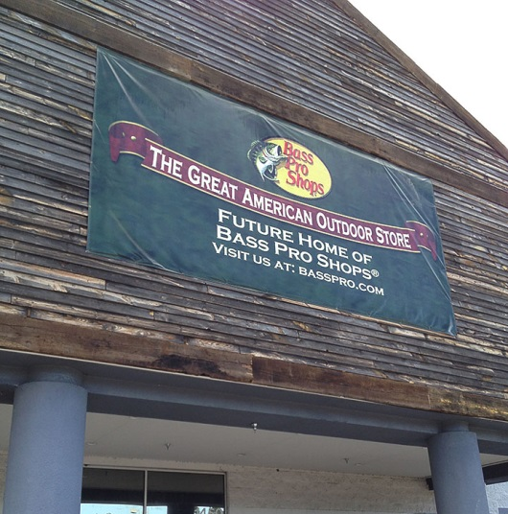
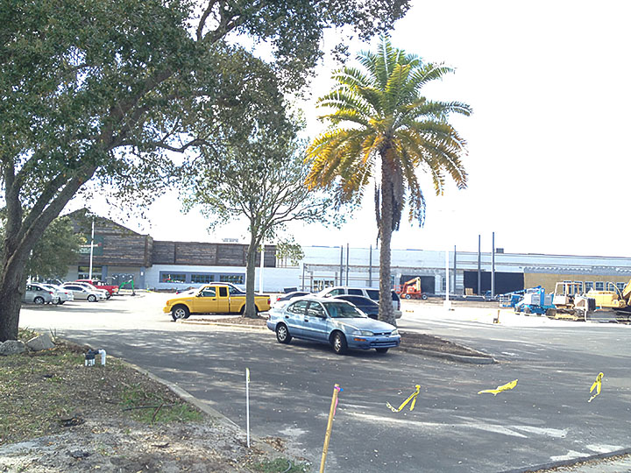
Signs of vitalty

Slide 25
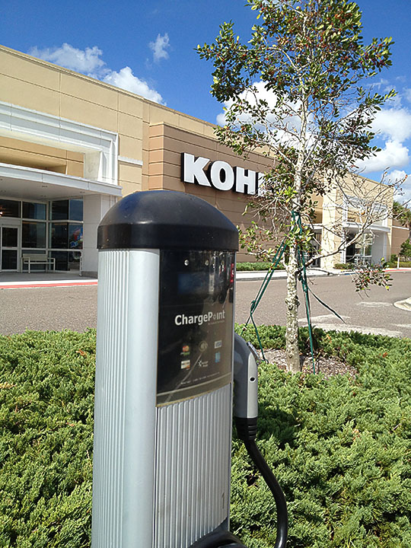
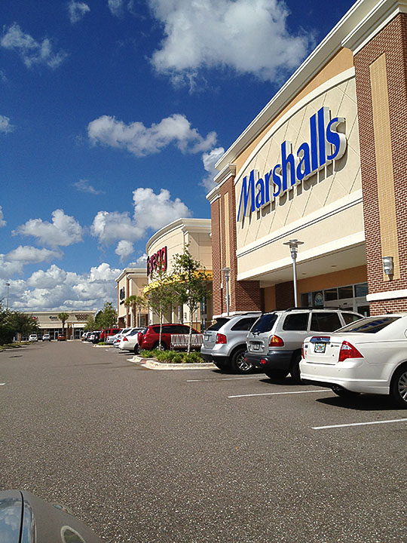
West melbourne

Slide 26
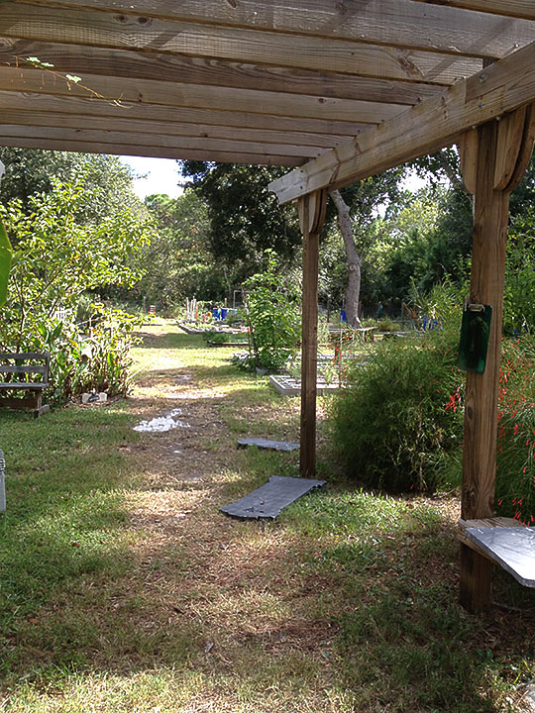
threads that connect us

Slide 27
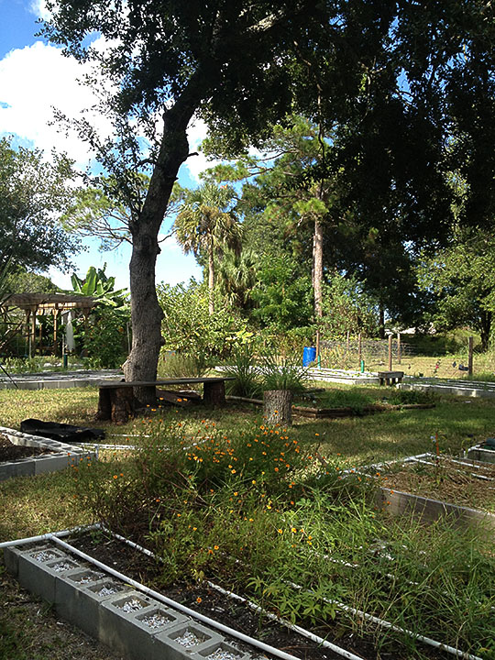
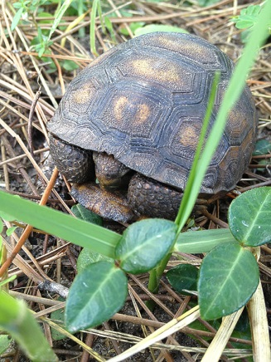
threads that connect us
Nemo Community Garden represents:
Land uses some other cities may not be able to embrace
Communities looking at shared work and reward
Identifying leaders, skills sharing
Trends in teaching next generation, applied values
Self sustainability lessons
Understanding our Earth and its systems
Respecting its inhabitants, all kinds of life
HOW MANY QUIET LESSONS CAN A COMMUNITY GARDEN TEACH?

Slide 28
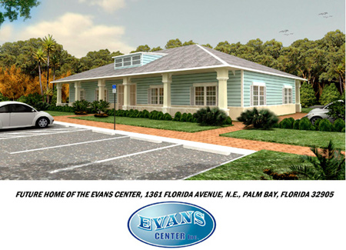
threads that connect us, showing character
The Evans Center Project
Using themes of history and community to evolve, regenerate ... IN THE NEIGHBORHOOD.
Classrooms for youth job training. A satellite health clinic for Driskell Heights and Powell Neighborhoods.
Example of attending to the needs of youth in Palm Bay and of community benefit organizations at their best.

Slide 29
threads that connect us
“At the heart of every community are our neighborhoods. They are what define us and give us an identity, character, and purpose. When residents are united they are able to identify needs and more effectively petition government for action.”
Organize. Name. Enhance.
http://www.palmbayflorida.org/growth/programs/one.html
one@pbfl.org

Slide 30
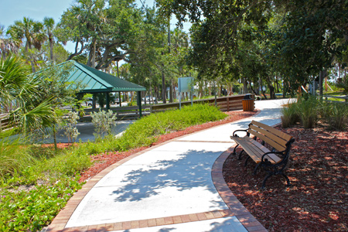
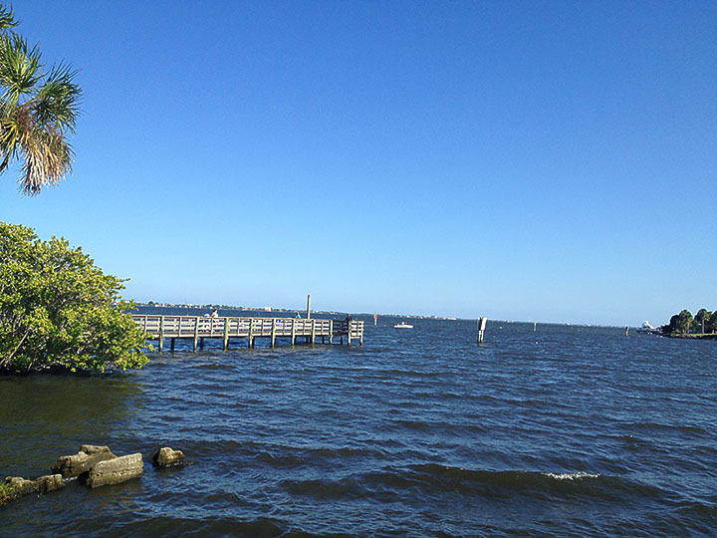
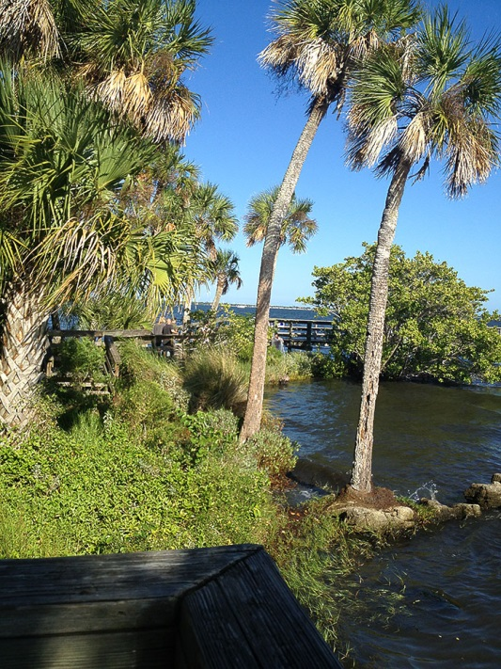
SIGNS OF VITALITY
Tangible reality and an opportunity to teach WHAT’S NEXT, why it matters, and some pieces that will need to fall into place to get there.
Castaway Point Park is a visual reference point.
Notes:
Sometimes all people need to know is WHAT IS THE PLAN? DO WE BELIEVE IT HAS A SHOT AT COMING TRUE? HOW LONG WILL IT TAKE TO GET THERE, MORE OR LESS?
AND ... If we have done our job right at that point, then ... They may also ask: HOW CAN I HELP? HOW DO I, MY COMPANY, MY ORGANIZATION, MY NEIGHBORHOOD GET BEHIND THIS? MOVE IT FORWARD?

Slide 31
Next and next and next
Your present circumstances don’t determine where you can go; they merely determine where you can start.
--Nido Qubein
Mindspot Research

Slide 32
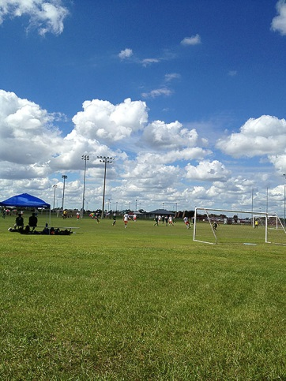
GROWING
Your Story
Opportunities & Actions

Slide 33
Palm Bay is in a dynamic cycle: 1. Advantages to Owners and their Employees. 2. Abundant natural riches and outdoor adventure options we can grow. 3. Enriched environment for growing families, nurturing talent, creating a sustainable pipeline, an achievable future.

Slide 34
Palm Bay has 1. Cultural Diversity 2. International appeal 3. An Openness to Ideas 4. A Respect for families 5. Innovative people programs that illustrate values and so many other stories yet to be told, to help create a viable shared future view.

Slide 35
These are the beginnings of your unique stories.
WHAT’s NEXT: encapsulate and articulate this platform visually, strategically and with a working theme that has the flexibility to allow multiple conversations, around our clusters.

Slide 36
How is that unique platform?
We are looking for something a little bit unexpected. It has to have depth, edges, implications ... and memory. People must be able to recall it, repeat it, think about it, believe it. So first of all, it has to be TRUE.
Mindspot Research

Slide 37
How does that translate to a unique platform?
It cannot be something every city can say.
It has to honor the citizens, respect the city, and be seen as smart. It has to have incredible FLEXIBILITY.

Slide 38
How does that translate to a unique platform?
It must be simple enough to marry to a number of positive story threads over time and subject matter, and opportunity. It must be strong enough to resonate with differently motivated people, businesses and engagement options.

Slide 39
Notes:
Brandt Ronat’s recommendation for positioning Palm Bay’s economic development outreach is in one part centered around the simplicity of the phrase itself and its effectively unassuming opening and surprisingly powerful stance, when seen in context of its many, many positive, related implications.
The idea of being ‘down to earth’ has edges.
It is not expected.
It is not something every City can say or then also load with actual relevant business or economic development value.
It is a way to identify the essential (and hidden, not instantly seen, vast and secret) economic opportunity within Palm Bay.
‘Down to earth’ is also a way to honor the residents and support the incredible natural assets of Palm Bay.
It allows us to secondarily and effectively focus on all of the wonderful assets its land and people offer. While the clear opportunity for growth is the vast available, affordable land and lease offers, the City of Palm Bay has other assets that provide for a winning combination.
It is crucial to note the underpinnings in the phrase: and explore its other stunning resonating implications.
From this we can provide a full portrait of a geographically and recreationally rich area, unsurpassed beauty and a lifestyle in Florida that is enviable.
The creative concept of being ‘down to earth’ literally establishes Palm Bay as a welcoming place of opportunity with a strong identity and solving nature.
It implicates a willingness by the City and its people to create options to make innovative development come true, find ways to consider a good idea, make doors open, support the processes, such as ways to accelerate permitting or other steps to get a business up and running and earning.
The traditional use of the phrase down to earth is a phrase attributed to ‘people’ which we think is an important point—that this profiles the people of the City of Palm Bay as accessible, direct, friendly, have conversations, meet you on level ground and look you in the eye, and are open to you and your ideas, your heritage, your business premise, your needs and your family of employees.

Slide 40
ENVIRONMENT
Notes:
CLUES: Palm Bay represents Openness:
1. Open and available richness and sheer amount of land 2. Innovative leaders Open to working a solution (grounded, down to earth people, not afraid to get their hands in and help solve) 3. Open-ended opportunity in an area that is EMERGING. With people that are open.

Slide 41
ECONOMICS
Notes:
CLUES: Palm Bay represents Openness:
1. Open and available richness and sheer amount of land 2. Innovative leaders Open to working a solution (grounded, down to earth people, not afraid to get their hands in and help solve) 3. Open-ended opportunity in an area that is EMERGING. With people that are open.

Slide 42
EMERGING
Notes:
CLUES: Palm Bay represents Openness:
1. Open and available richness and sheer amount of land 2. Innovative leaders Open to working a solution (grounded, down to earth people, not afraid to get their hands in and help solve) 3. Open-ended opportunity in an area that is EMERGING. With people that are open.

Slide 43
What words describe you?

Slide 44
Grounded. Approachable. Not afraid to work or to innovate. Looking for new shoots, new growth. Willing to partner, get your hands in to help solve. Good stewards for the City. Good stewards for the future, the people. Willing to go the distance.

Slide 46
Environment. Economics. Emerging Opportunities.
Notes:
Brandt Ronat’s recommendation for positioning Palm Bay’s economic development outreach is in one part centered around the simplicity of the phrase itself and its effectively unassuming opening and surprisingly powerful stance, when seen in context of its many, many positive, related implications.
The idea of being ‘down to earth’ has edges.
It is not expected.
It is not something every City can say or then also load with actual relevant business or economic development value.
It is a way to identify the essential (and hidden, not instantly seen, vast and secret) economic opportunity within Palm Bay.
‘Down to earth’ is also a way to honor the residents and support the incredible natural assets of Palm Bay.
It allows us to secondarily and effectively focus on all of the wonderful assets its land and people offer. While the clear opportunity for growth is the vast available, affordable land and lease offers, the City of Palm Bay has other assets that provide for a winning combination.
It is crucial to note the underpinnings in the phrase: and explore its other stunning resonating implications.
From this we can provide a full portrait of a geographically and recreationally rich area, unsurpassed beauty and a lifestyle in Florida that is enviable.
The creative concept of being ‘down to earth’ literally establishes Palm Bay as a welcoming place of opportunity with a strong identity and solving nature.
It implicates a willingness by the City and its people to create options to make innovative development come true, find ways to consider a good idea, make doors open, support the processes, such as ways to accelerate permitting or other steps to get a business up and running and earning.
The traditional use of the phrase down to earth is a phrase attributed to ‘people’ which we think is an important point—that this profiles the people of the City of Palm Bay as accessible, direct, friendly, have conversations, meet you on level ground and look you in the eye, and are open to you and your ideas, your heritage, your business premise, your needs and your family of employees.

Slide 47
Just a bit unexpected.
Offer depth, edges, implications about you.
Easy, lyrical: Induces memory, repetition, belief.
Reflect what is authentic, TRUE.
It must reflect & support the strategic platform.
Mindspot Research

Slide 49
THE END
(The Beginning)
Opportunities & Actions

Slide 50
About mobilizing
Most worthwhile achievements are the result of many little things done in a single direction.
--Nido Qubein
Mindspot Research
Notes:
That is certainly true of communications.

Slide 51
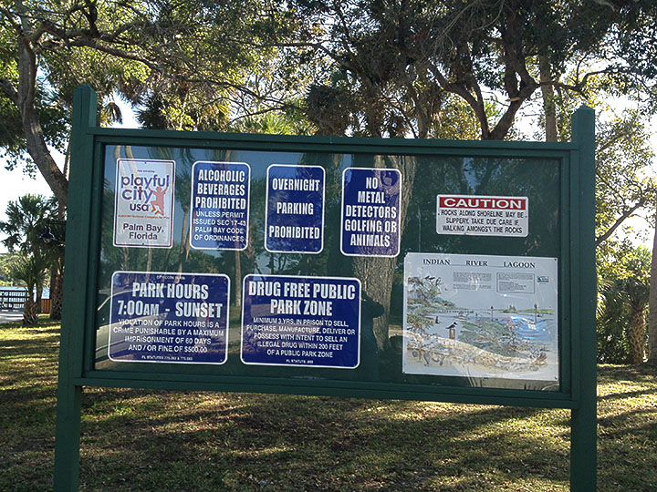
MANY OPPORTUNITIES

Slide 52
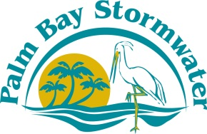
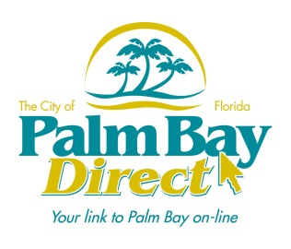
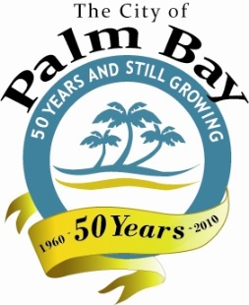
Notes:
Brandt Ronat’s recommendation for positioning Palm Bay’s economic development outreach is in one part centered around the simplicity of the phrase itself and its effectively unassuming opening and surprisingly powerful stance, when seen in context of its many, many positive, related implications.
The idea of being ‘down to earth’ has edges.
It is not expected.
It is not something every City can say or then also load with actual relevant business or economic development value.
It is a way to identify the essential (and hidden, not instantly seen, vast and secret) economic opportunity within Palm Bay.
‘Down to earth’ is also a way to honor the residents and support the incredible natural assets of Palm Bay.
It allows us to secondarily and effectively focus on all of the wonderful assets its land and people offer. While the clear opportunity for growth is the vast available, affordable land and lease offers, the City of Palm Bay has other assets that provide for a winning combination.
It is crucial to note the underpinnings in the phrase: and explore its other stunning resonating implications.
From this we can provide a full portrait of a geographically and recreationally rich area, unsurpassed beauty and a lifestyle in Florida that is enviable.
The creative concept of being ‘down to earth’ literally establishes Palm Bay as a welcoming place of opportunity with a strong identity and solving nature.
It implicates a willingness by the City and its people to create options to make innovative development come true, find ways to consider a good idea, make doors open, support the processes, such as ways to accelerate permitting or other steps to get a business up and running and earning.
The traditional use of the phrase down to earth is a phrase attributed to ‘people’ which we think is an important point—that this profiles the people of the City of Palm Bay as accessible, direct, friendly, have conversations, meet you on level ground and look you in the eye, and are open to you and your ideas, your heritage, your business premise, your needs and your family of employees.

